Slide 1

E-practical training
Students:
1. Mohammad Abdallah 2. Ali Alqawasmeh
Second term 2021/2022
Supervisor:
Hasan Abualese

Slide 2
Outline
Introduction
Related work
Problem statement
Project objectives
Gantt chart
Methodology
Data collection
Design models
Conclusion

Slide 3
Introduction
This project deals with the idea of a gradual transition to electronic transactions. Our project begins through contracts between technology companies and the university to help the student find a training company and facilitate the application to the companies.

Slide 4
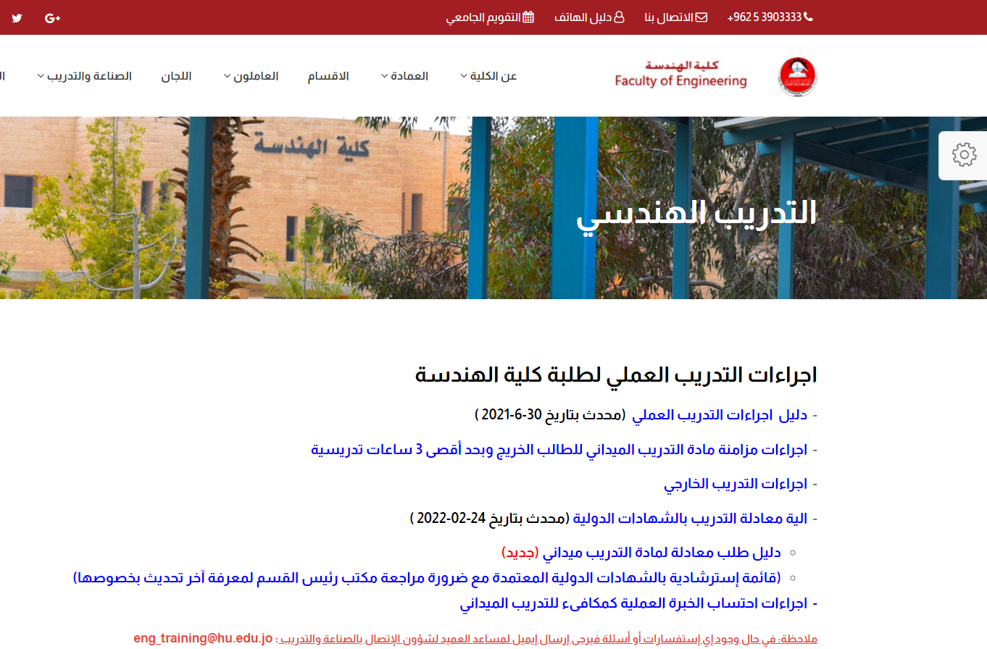
Related work
The Hashemite University
A similar application at Hashemite University in the College of Engineering to train practical students.

Slide 5
Problem statement
1- The problem of routine procedures in submitting the application, where the student must go to more than one place to be able to apply.
2- Some students face a problem in finding a training company for them, as problems may occur because of this in terms of delay in training.
3- The problem of the paper and routine procedures, which must be transferred to an electronic form for the development of the university.

Slide 6
Project objectives
1- Creating an electronic platform in the student portal that allows him to apply for practical training electronically.
2- Helping the student to find a suitable company for training by providing a number of suggestions.
3- Contributing to the development of the university by converting paper-based procedures to electronic ones.
4- Contribute to the development of relations between technology companies and the university through contracts between them.

Slide 7
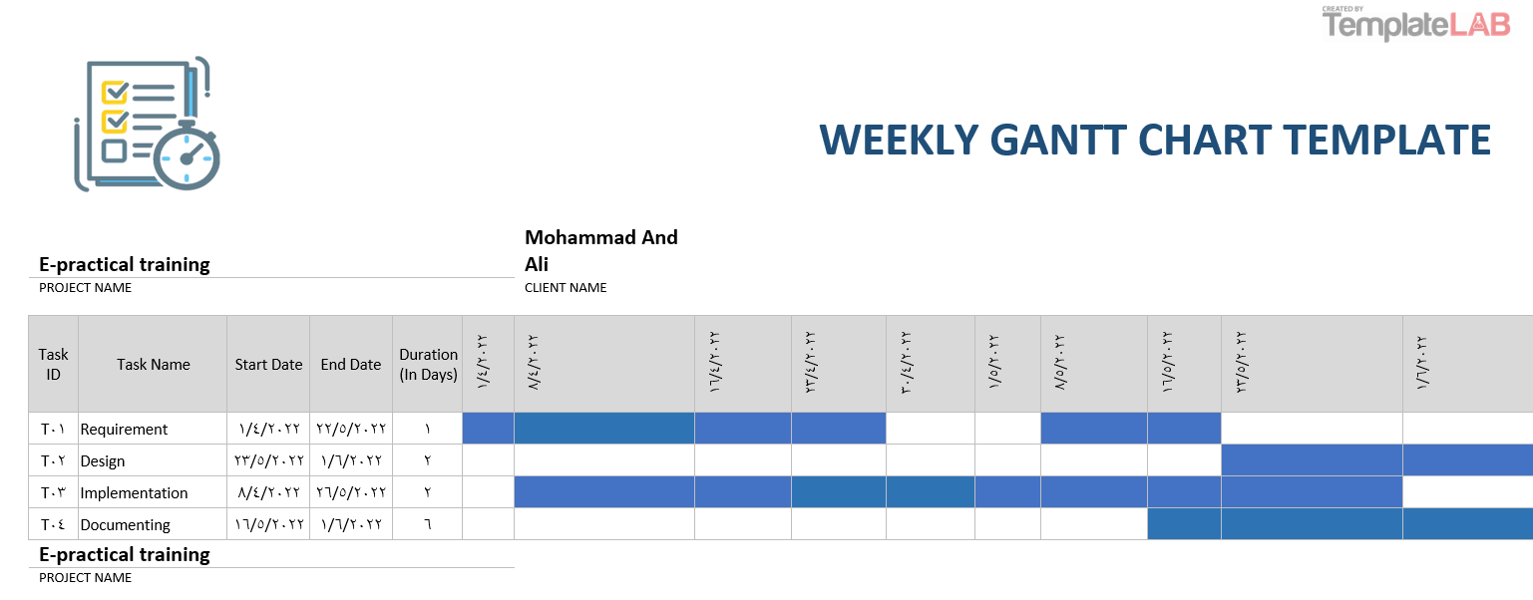
Gantt chart

Slide 8
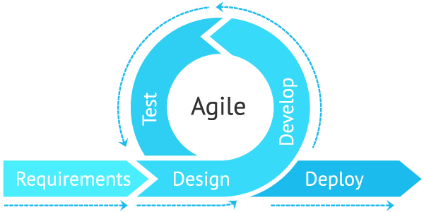
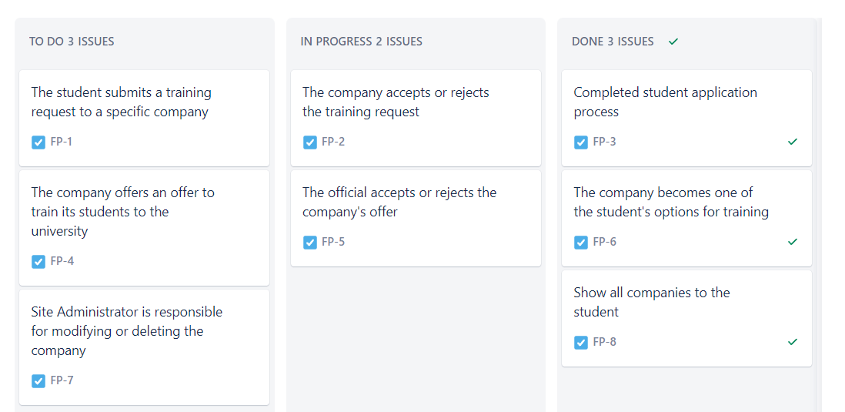
Methodology
We’ve used the agile methodology as well as the Kanban board method in developing this project.
Advantages of Kanban:
It reduces the time cycle of the process.

Slide 9
Data collection
Interviews:
The interview technique was used, which is based on collecting information from some individuals at the university in order to be able to apply it in the project.

Slide 10
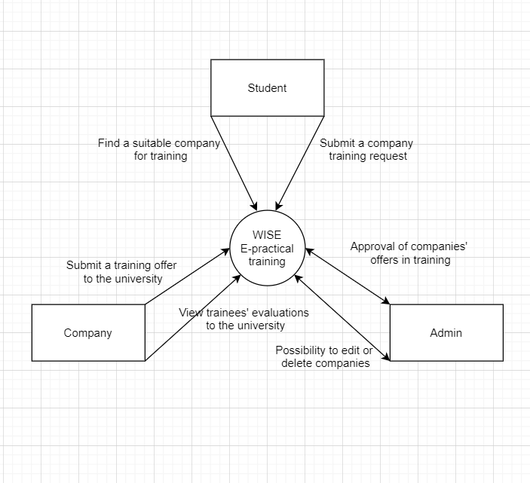
Design models
Context diagram:

Slide 11
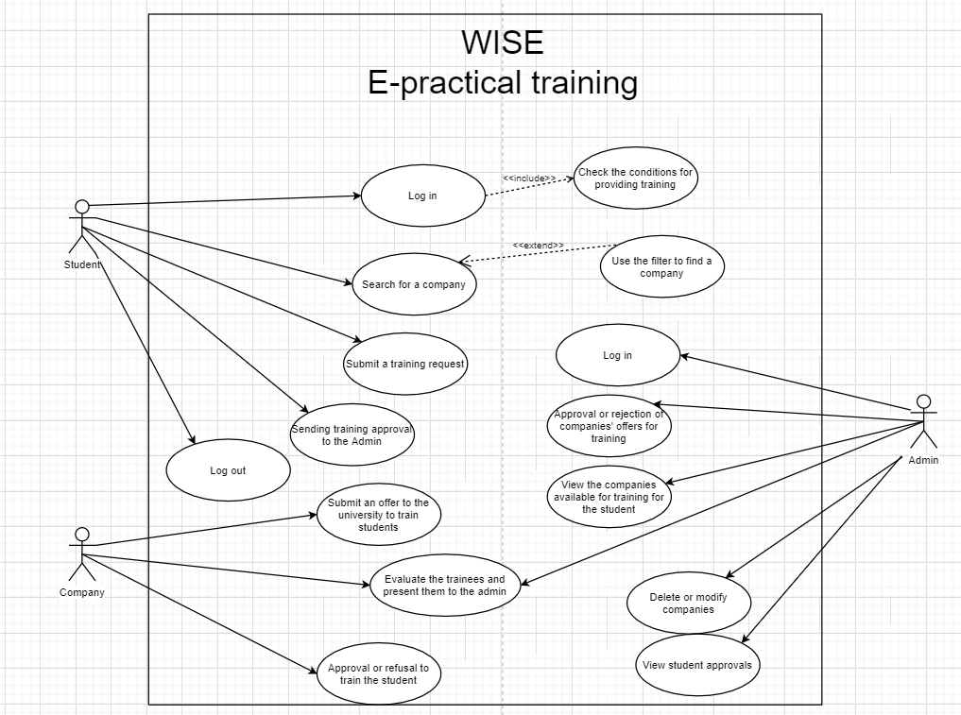
Design models
Use case diagram:

Slide 12
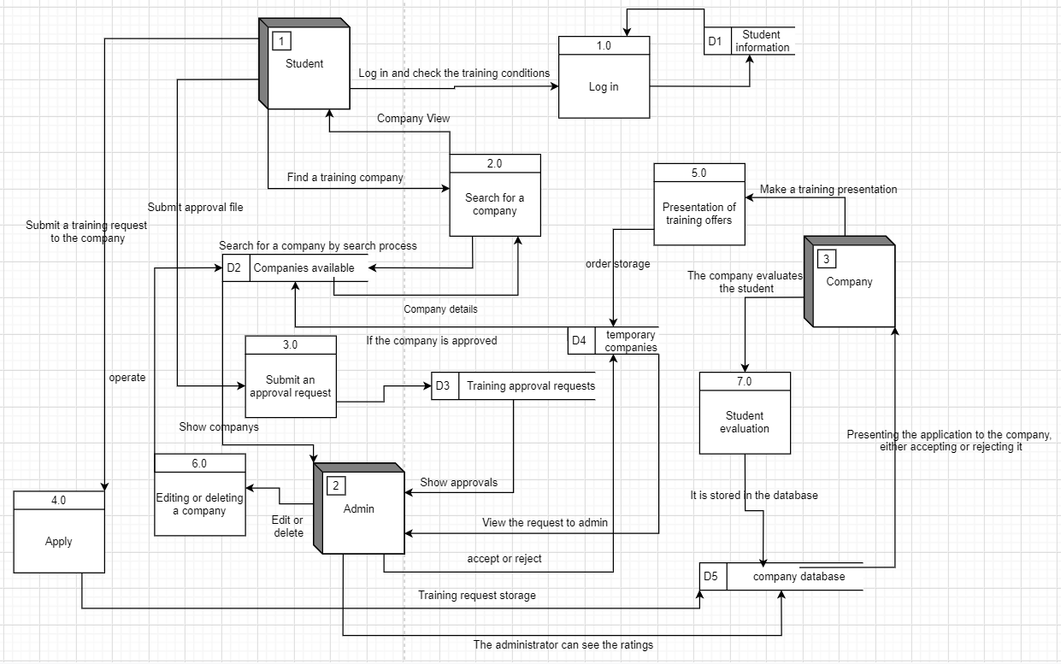
Design models
Data flow diagram:

Slide 13
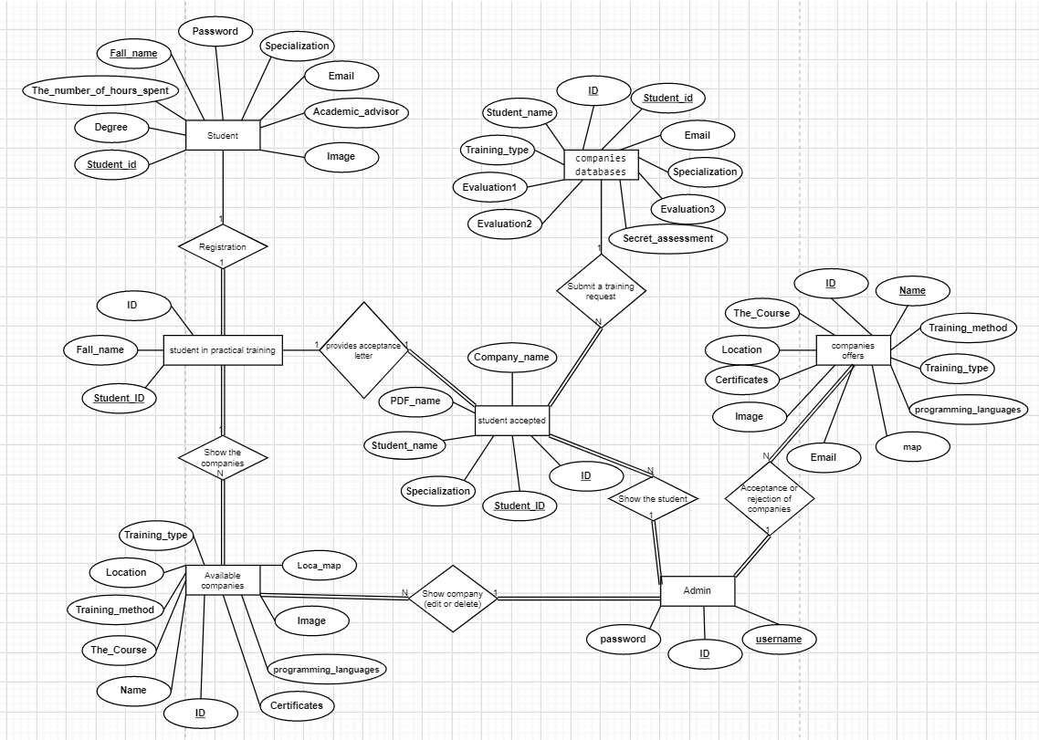
Design models
Entity-relationship diagram:

Slide 14
Conclusion
1- Contributing to creating a new field of cooperation between the university and technical companies.
2- Helping the student by providing an appropriate number of companies available for training.
3- Facilitating for the student to apply for training through the company’s website and direct communication between them.
4- Facilitating the student by submitting the approval report to the university through the website.

